Slide 1
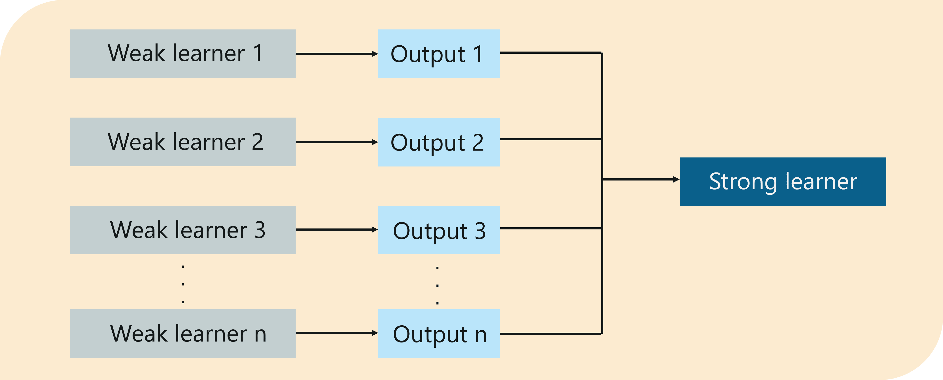
BOOSTING
It is a ensemble modelling technique that attempts to build a stronger model from number of weaker model
Need for boosting
turning a weak model to a stronger one to fix its weaknesses

Slide 2
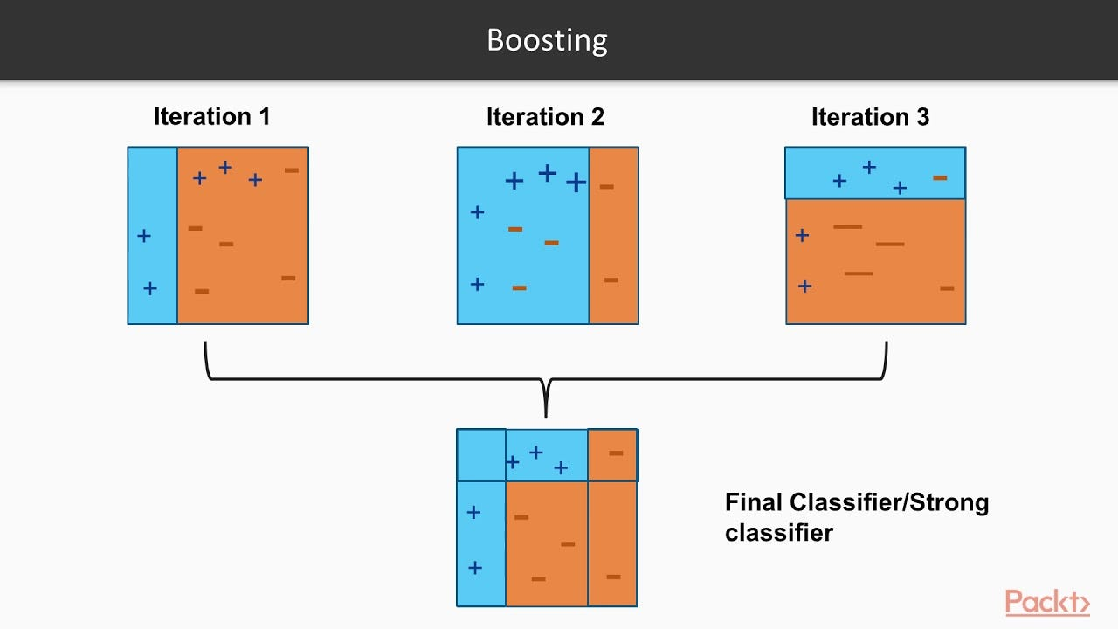
Ada boost
Ada boost is also known as adapative boost
It resign- weight to each instance
Higher weight for incorrect classifer
Reduce the bias and variance
Used for both regression and classification

Slide 3
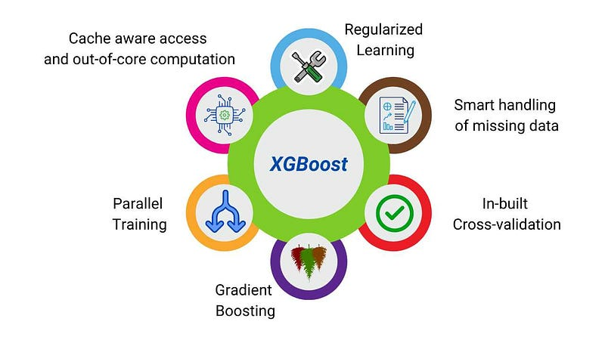
XG Boost
XG boosting is also known as Extreme gradient boosting
It is distributed machine learning process
Its mainly used complicated dataset
Distributed computing
Parallelization

Slide 4
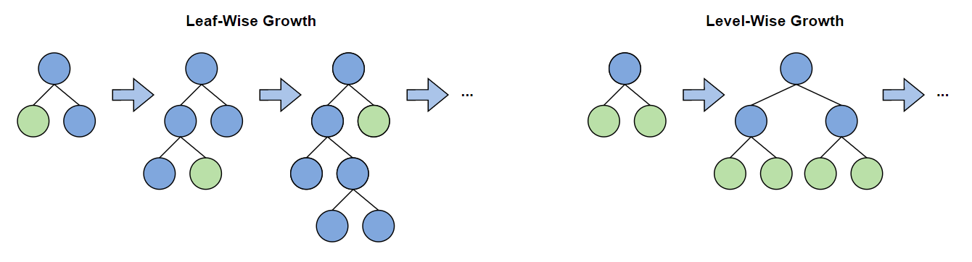
LG Boost
LG boost is also known as Light gradient boost
In LB boost decision trees are grown leaf wise meaning that at a single time only one leaf from the whole tree will be grown.
It is used handle huge amount of data easily
Poor result in small dataset
Leaf-wise Growth

